Slide 1

Bootstrap framework
By Natasha Scott

Slide 2
About bootstrap
Bootstrap is a free front-end framework used for faster and easier web development. It includes HTML and CSS based design templates for typography, forms, buttons, tables, navigation, modals, image carousels, and many other, as well as optional JavaScript plugin. Bootstrap gives you the ability to easily create responsive designs to work with multiple devices and browsers. It also uses a mobile-first approach for websites.

Slide 3
Advantages of bootstrap
Saves time and effort using the Bootstrap predefined design templates and classes.
Easily create responsive websites for different devices and screen resolutions.
Consistent design templates and styles.
Easy to use.
Compatible with all modern browsers.
Open Source, which is completely free to download and use.
Uses a mobile-first approach.
Lots of free and professional templates, WordPress themes, and plugins.

Slide 4
Disadvantages of bootstrap
Requires that you know how to code.
Its naming scheme can be confusing.
Not ideal for a small, simple site.
You may become too reliant on it

Slide 5
Issues encountered using bootstrap
The main issue I encountered while using Bootstrap was trying to find components for Bootstrap 4. Most of the components I found were for Bootstrap 5.

Slide 6
Bootstrap installation
Go to https://getbootstrap.com.
You can download bootstrap, include it via a CDN, or install it via a package manager, such as npm or yarn.
I will be showing my demo using the CDN.

Slide 7
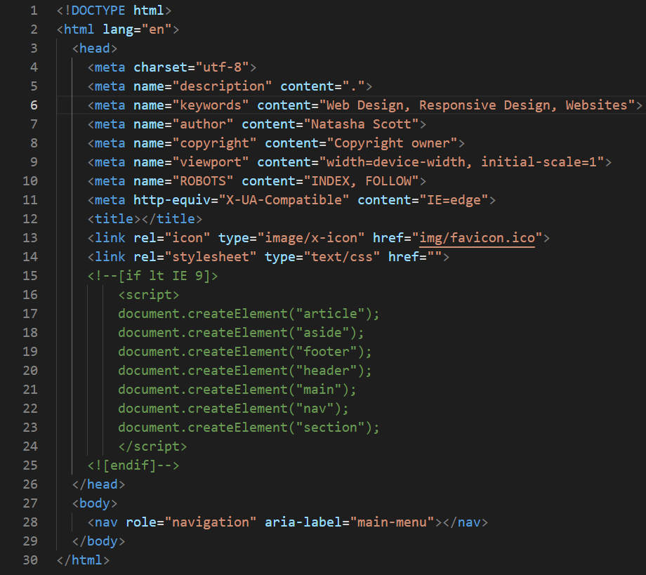
Create an html page

Slide 8
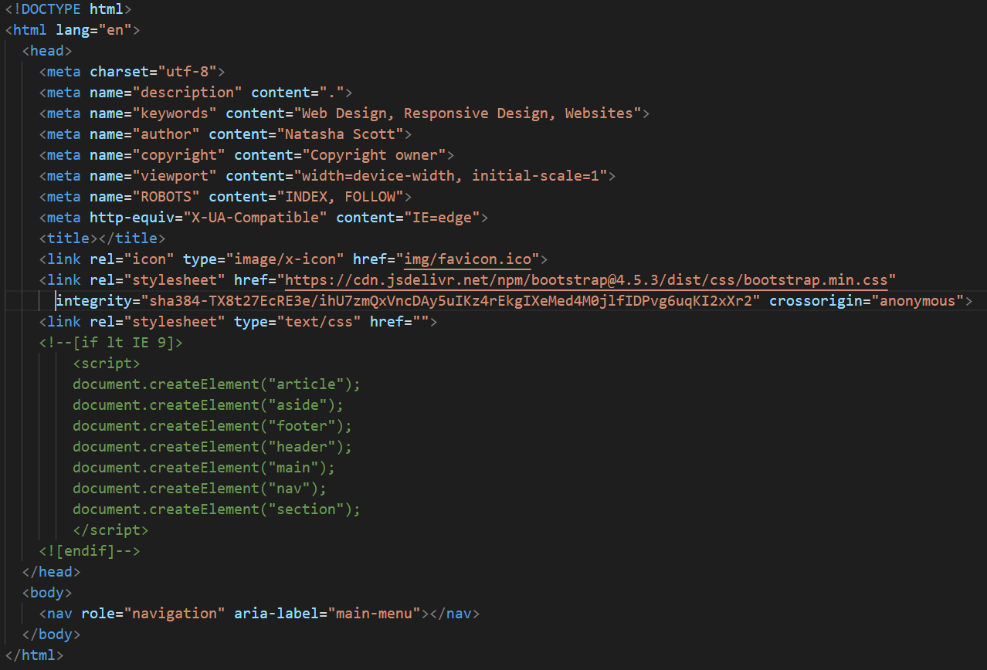
Load bootstrap via cdn

Slide 9
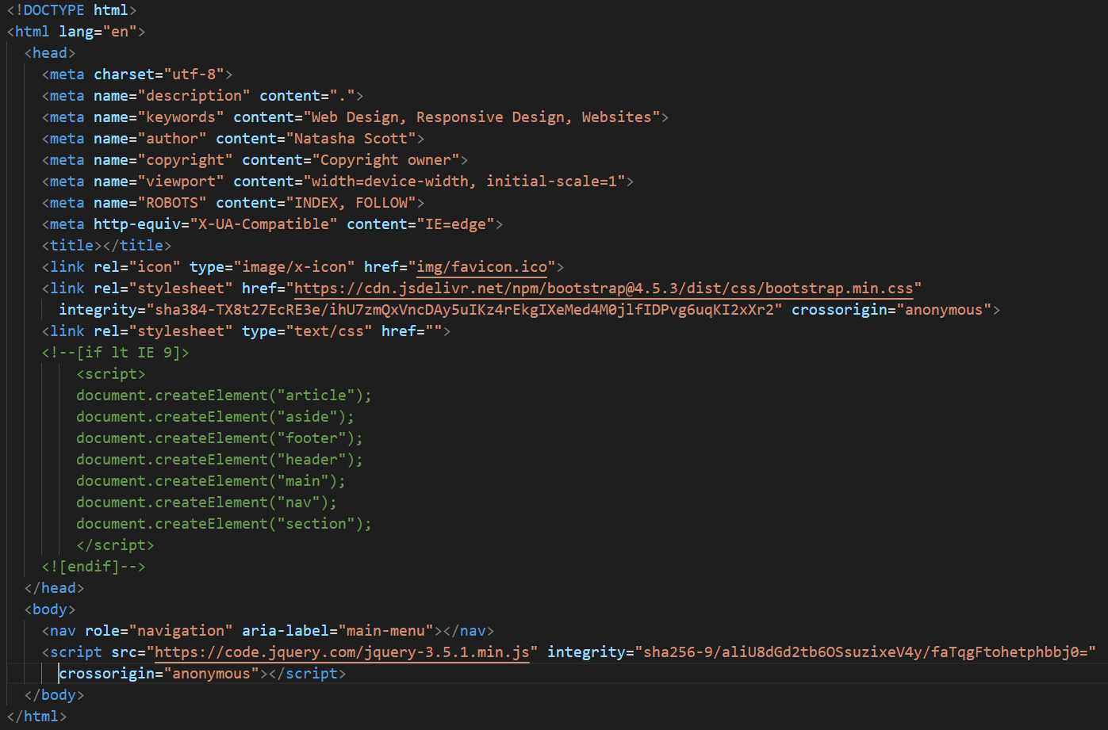
Include jquery*
*Bootstrap 5 does not use jQuery.

Slide 10
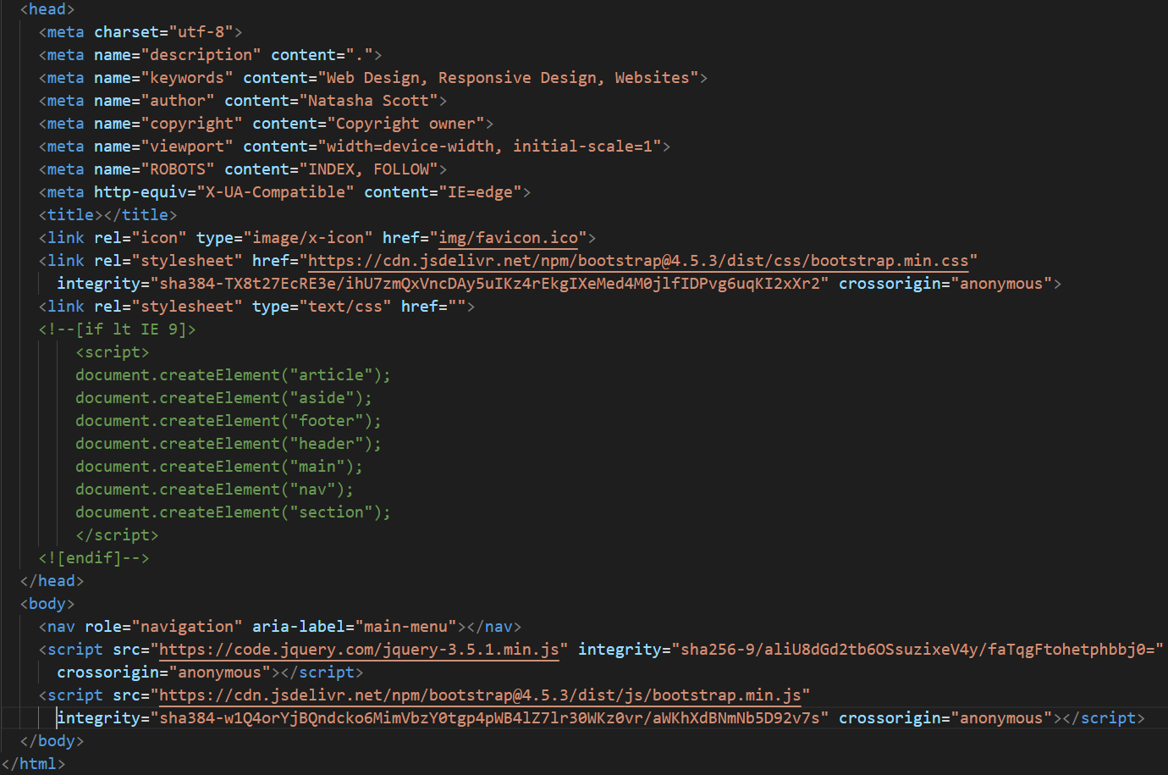
Load bootstrap javascript

Slide 11
Employment of bootstrap

Slide 12
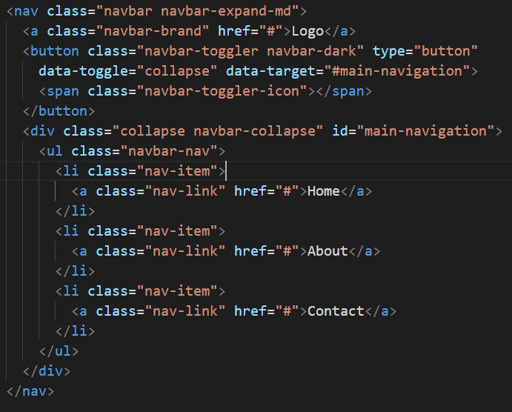
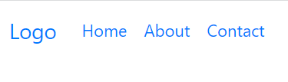
Add a navigation bar

Slide 13
Bootstrap customization

Slide 14
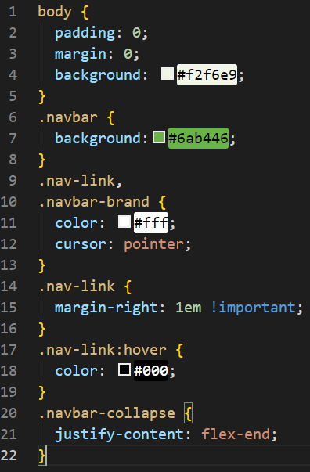
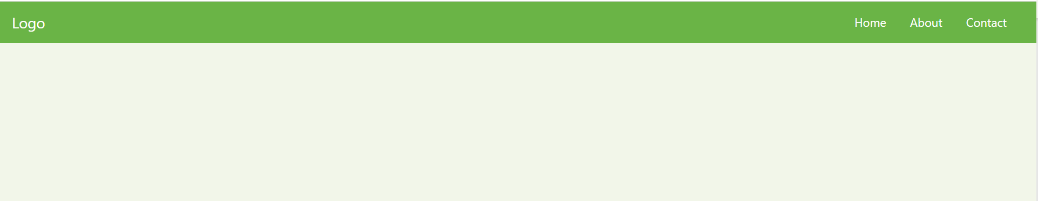
Include custom css

Slide 15

Create a page content container

Slide 16
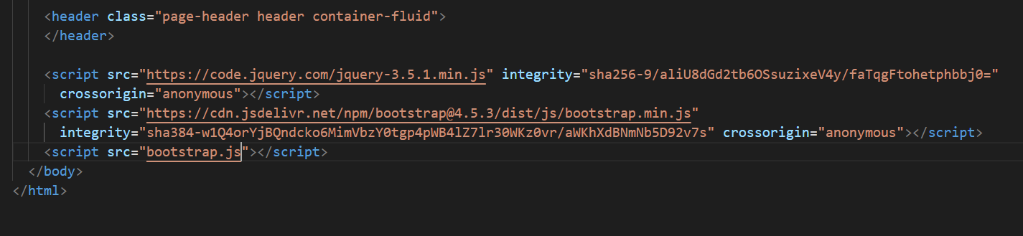
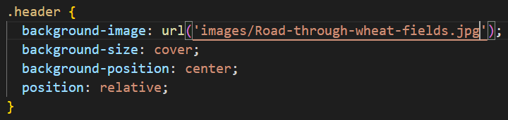
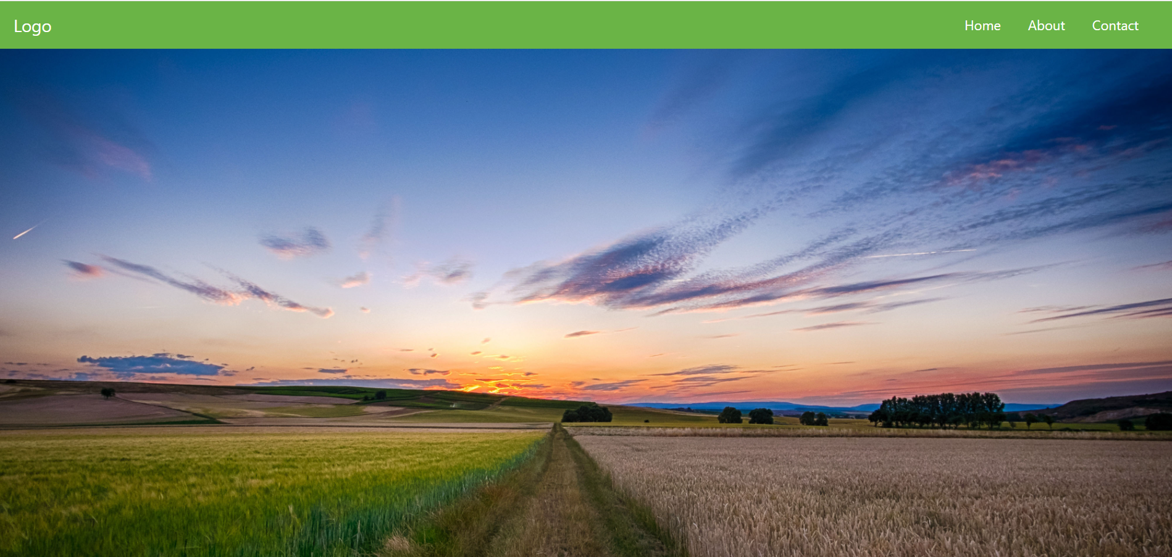

Add a background image and custom js

Slide 17
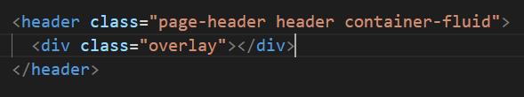
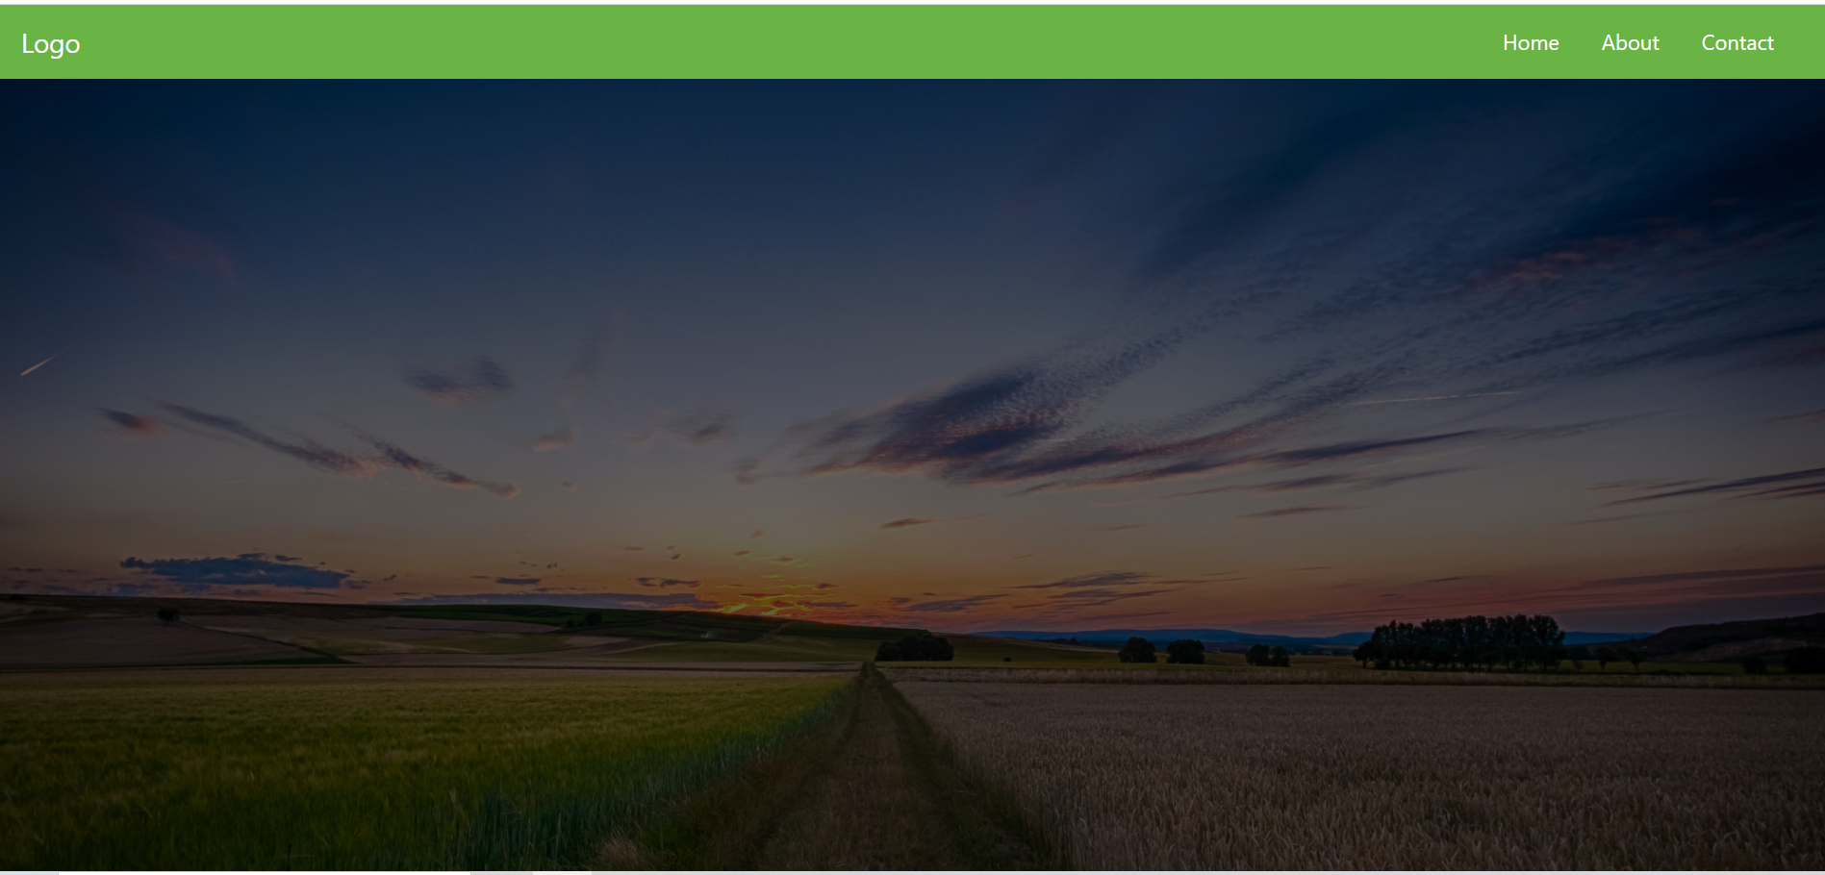
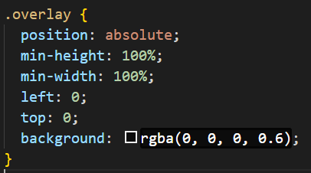
Add an overlay

Slide 18
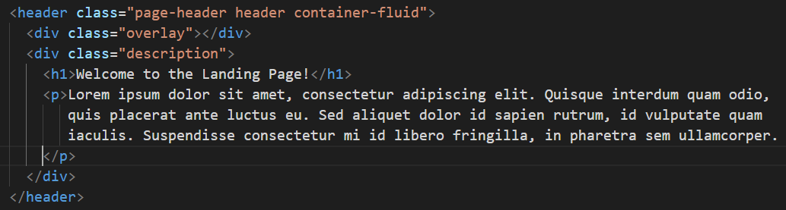
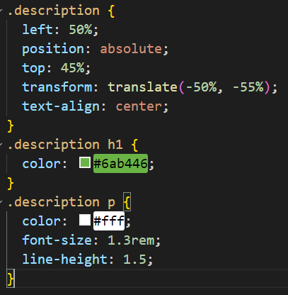
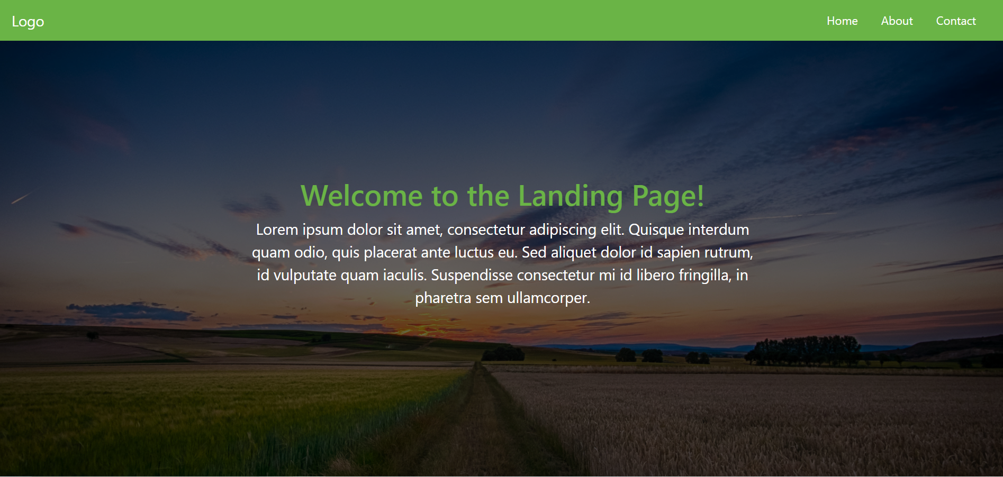
Include a page title and body text

Slide 19
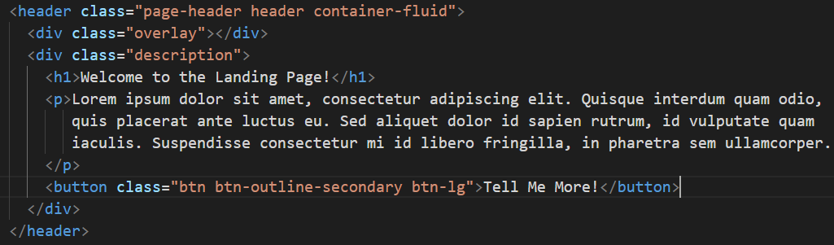
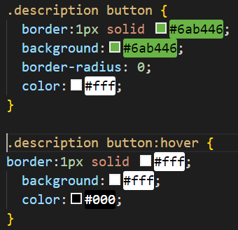
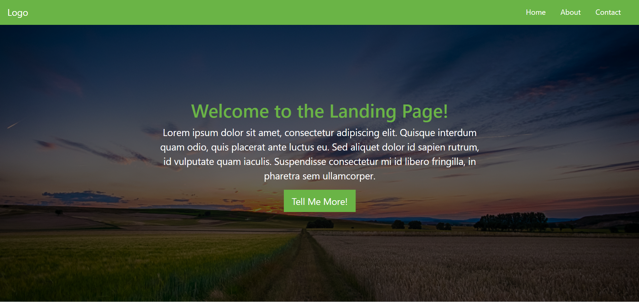
Create a cta button

Slide 20
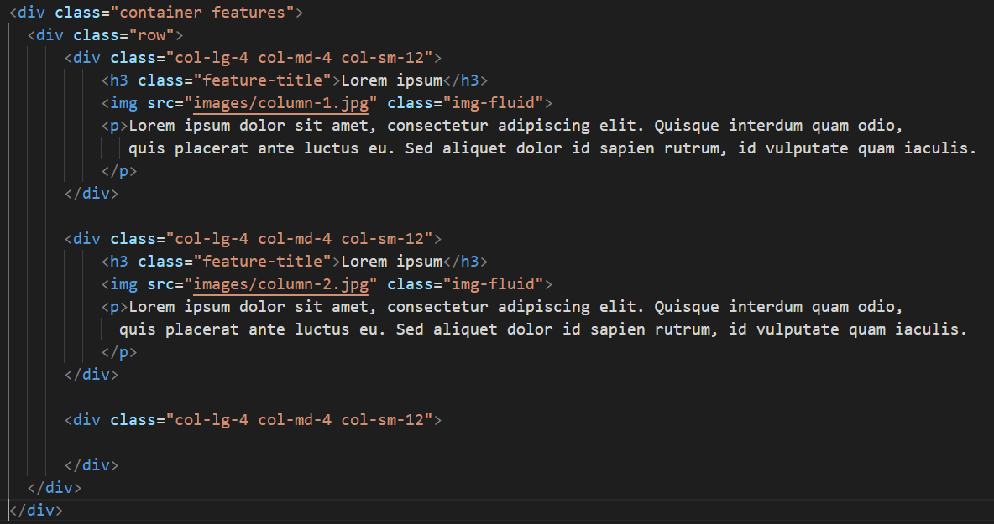
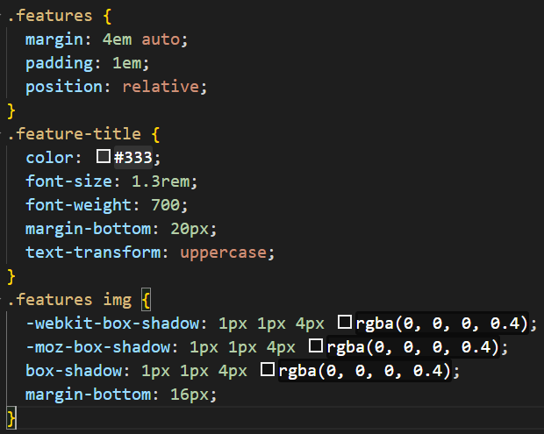
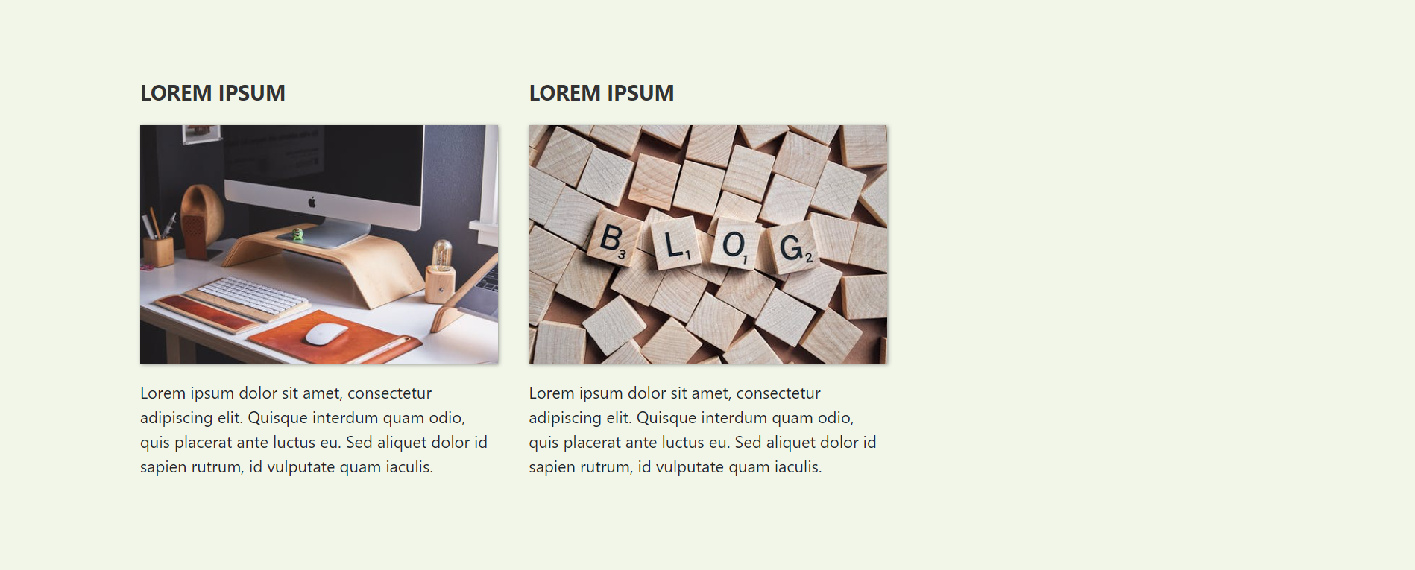
Setup a three-column section

Slide 21
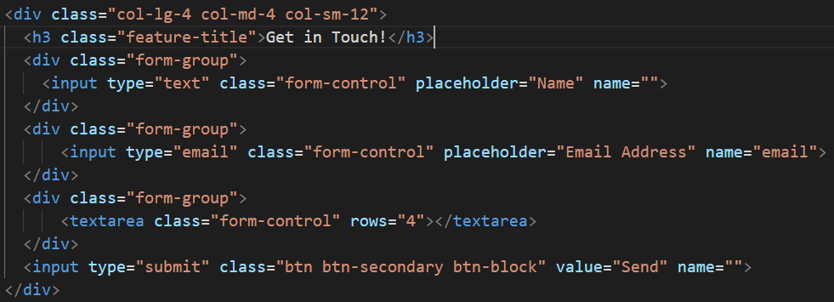
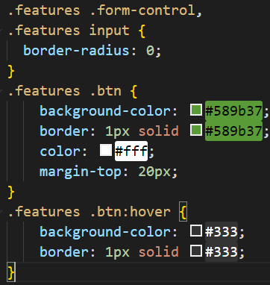
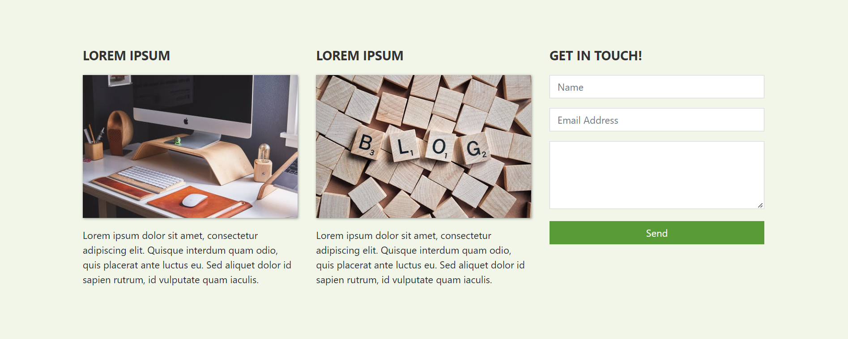
Add a contact form

Slide 22
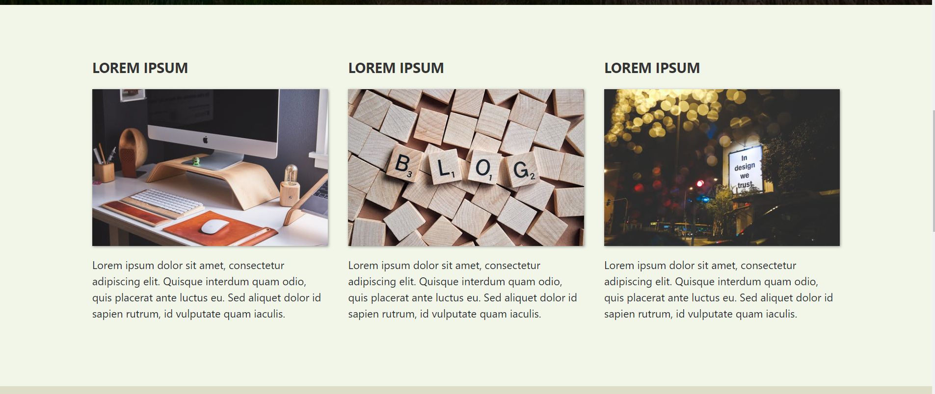
Customized pages using bootstrap

Slide 23
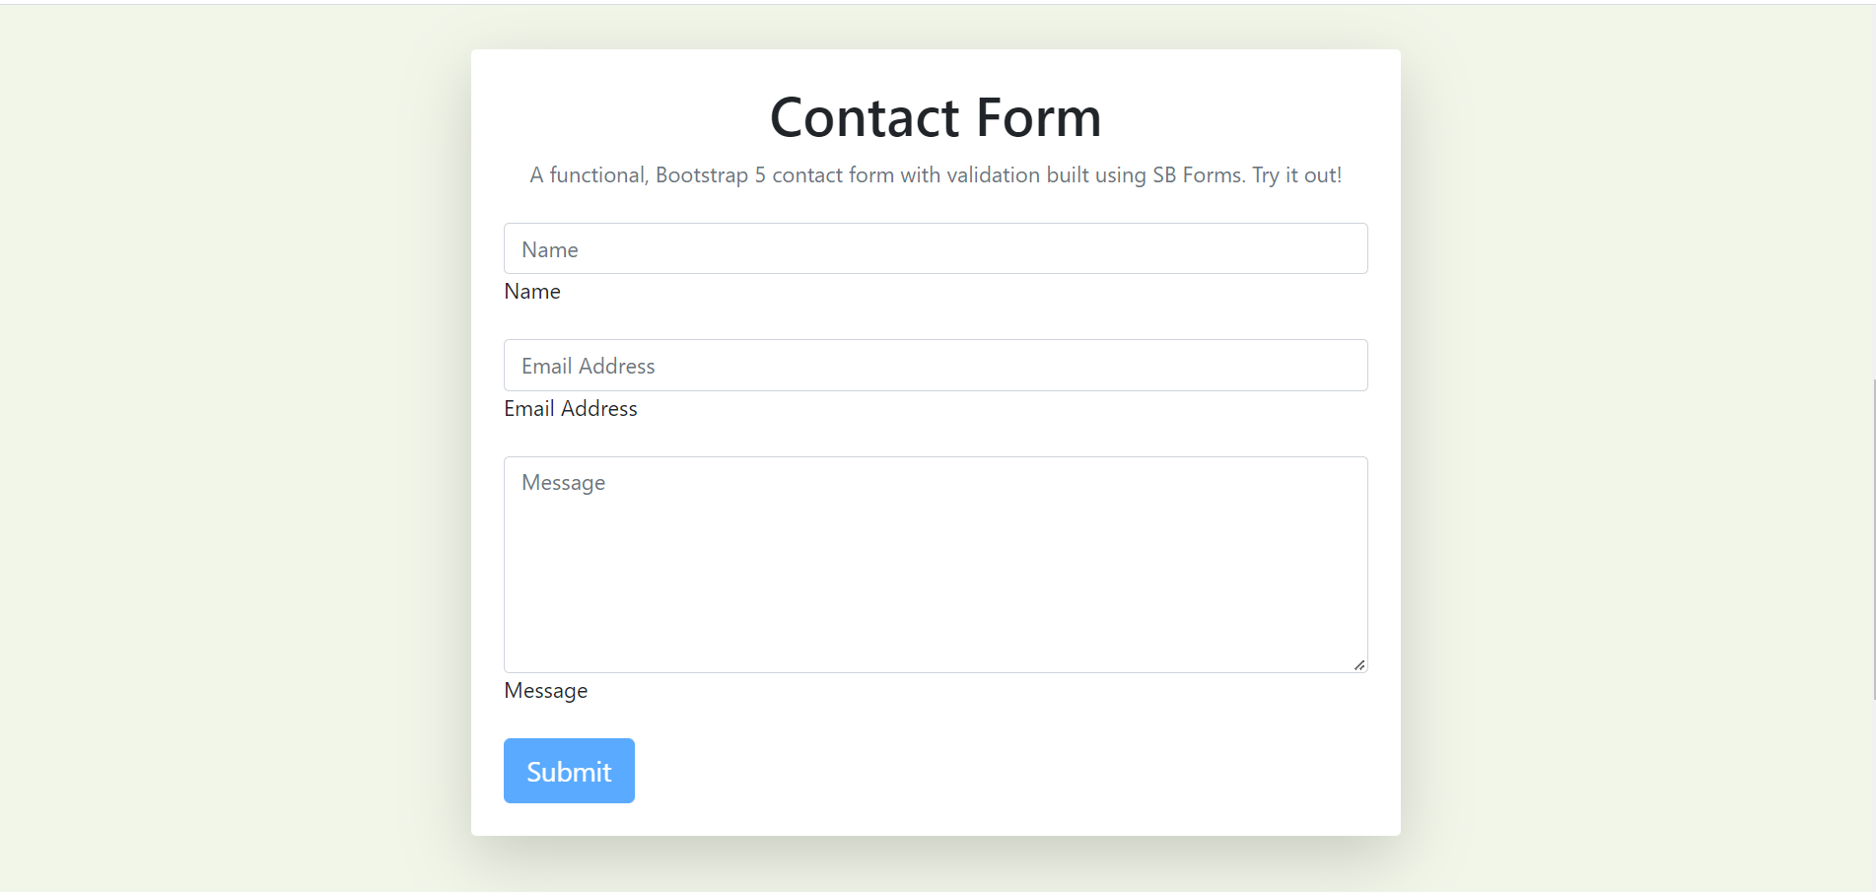
Custom contact form

Slide 24
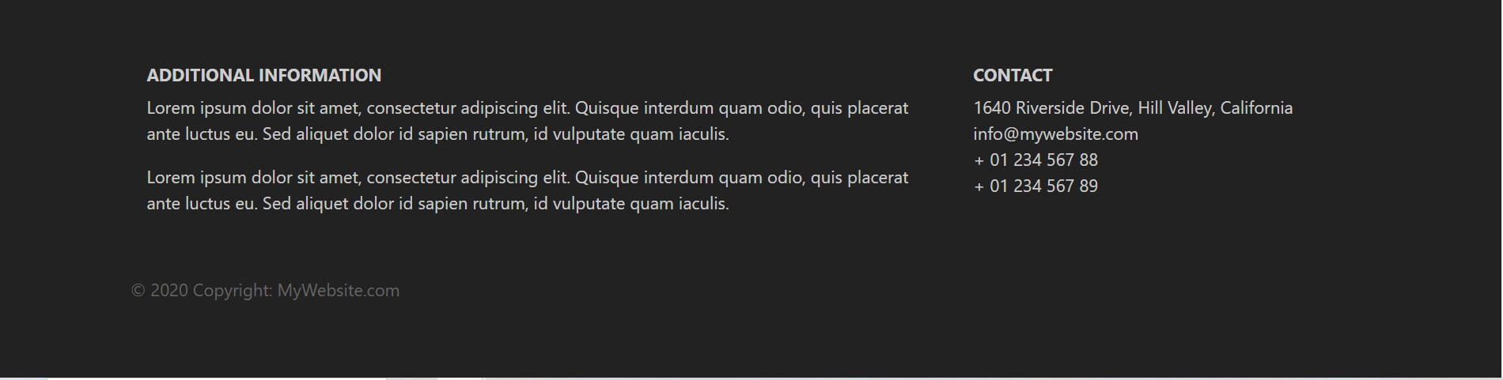
Custom footer

Slide 25
Bootstrap resources
https://getbootstrap.com/docs/3.4/getting-started/#examples
https://www.w3schools.com/bootstrap4/default.asp
https://websitesetup.org/bootstrap-tutorial-for-beginners/
https://www.tutorialrepublic.com/twitter-bootstrap-tutorial/
https://hackr.io/tutorials/learn-bootstrap
https://bootstrapcreative.com/pros-cons-using-bootstrap-web-development/#The_Different_Ways_to_Use_Bootstrap_in_Your_Project

